Slide 1
Potential Gentrification Trends of New York City Airbnbs and Listing Price Prediction
Josh Kim

Slide 2
Background
There exist abundant literature which focused on various socioeconomic impact Airbnbs had on New York City such as gentrification until 2017.
BUT what about after 2017? This paper aims to fill that gap by analyzing data from 2016-2020.

Slide 3
Previous Literature
Airbnb Price Prediction Using Machine Learning and Sentiment Analysis
Best model having R Squared score of 69% and MSE defined on ln(price) of 0.147.
Airbnb Pricing Predictions, Samuel Lam, Data Scientist at Uber (https://airbnb-pricing-prediction.herokuapp.com/)
Dataset with more than 50 features and the best model scored $21.43 for its Median Absolute Error.

Slide 4
Goals?
I aim to beat the best scores these previous research attained.
Median Absolute Error (less weight on large errors)
Nevertheless, I recorded three other metrics – Mean Absolute Error, R Squared, and Mean Squared Error.
Offer insights on how various characteristics of New York City Airbnb listings, especially gentrification trends, have changed in the most recent 3 years (2017-2020).

Slide 5
Data
Inside Airbnb Data
Independent, non-commercial set of tools and data that allows users to explore how Airbnb is really being used in cities around the world. Not associated with or endorsed by Airbnb or any of Airbnb's competitors.
5 data sets from the website, each of them from year 2016 to 2020 respectively.
Neighborhood Tabulation Areas (NTA) Data
Geospacial Shape Information for granular / meticulous map visualization

Slide 6
Findings from Exploratory Data Analysis

Slide 7
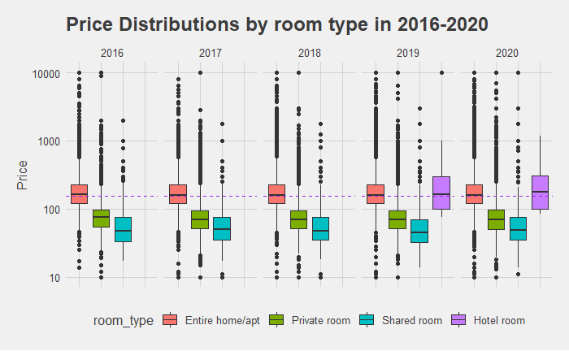
Price Distributions by Room Type
Private Room Listings
2018 ➔ 2020
40% Increase in Average Price
Useful feature for price prediction?

Slide 8
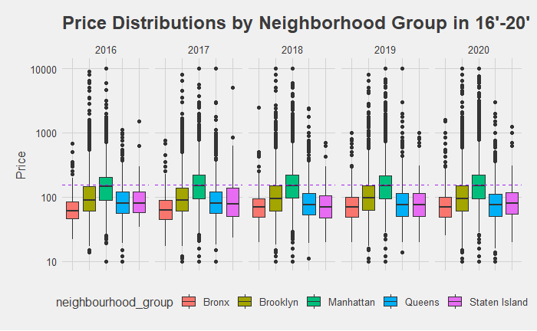
Price Distributions by Boroughs
Manhattan and Bronx
2016 ➔ 2020
20+% Increase in Average Price
Useful feature for price prediction?

Slide 9
Luxurious Airbnb Listings
 | 2017 | 2020
Manhattan | 66.7% | 73.8%
Brooklyn | 28.6% | 22.2%
Queens | 4.1% | 3.2%
Bronx | 0.4% | 0.6%
Staten Island | 0.2% | 0.2%
Luxurious Listings
Price > Q3+IQR * 1.5 for each year
Manhattan, Bronx
Recorded increase of more than 20% in average listing price from 2016 to 2020.
Increase in luxurious listings being posted in Airbnb in Manhattan and Bronx was driving up the average price of Airbnbs in those two boroughs.

Slide 10
Luxurious Airbnb Listings (continued)
Observed that neighborhoods including Midtown, Chelsea, Williamsburg and Lower East Side which were considered to be gentrified already in 2017 had the highest percentage of luxurious Airbnb listings.
Potential association between having high proportion of luxurious listings and the degree of gentrification that happened in those areas?
SoHo, Tribeca and Nolita / Upper East Side and West Village (Luxurious Listings Rising Stars in 2020 compared to 2018)
SoHo, Tribeca and Nolita are situated in Lower Manhattan which wasn’t the most gentrified area in 2018 compared to Midtown. Gentrification has been intensifying or is almost complete in Lower Manhattan?
Upper East Side and West Village which barely had any luxurious listings in 2017. But These two neighborhoods are, as the names suggest, adjacent to Upper West Side and East Village and these two neighborhoods had the highest percentage of luxurious listings combined in 2017.
Spill over effect to the adjacent regions?

Slide 11
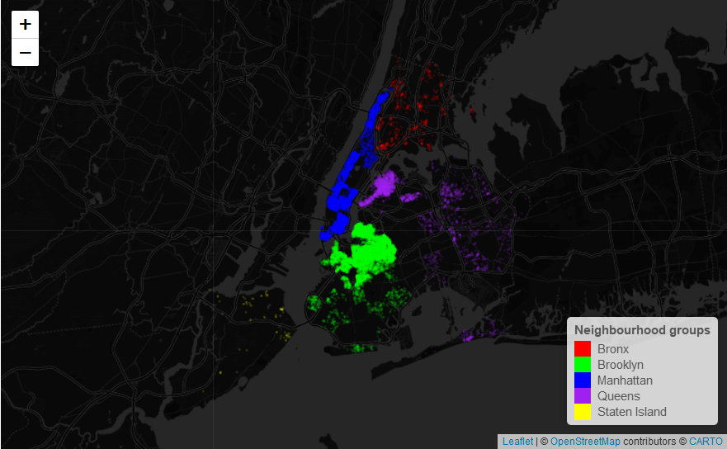
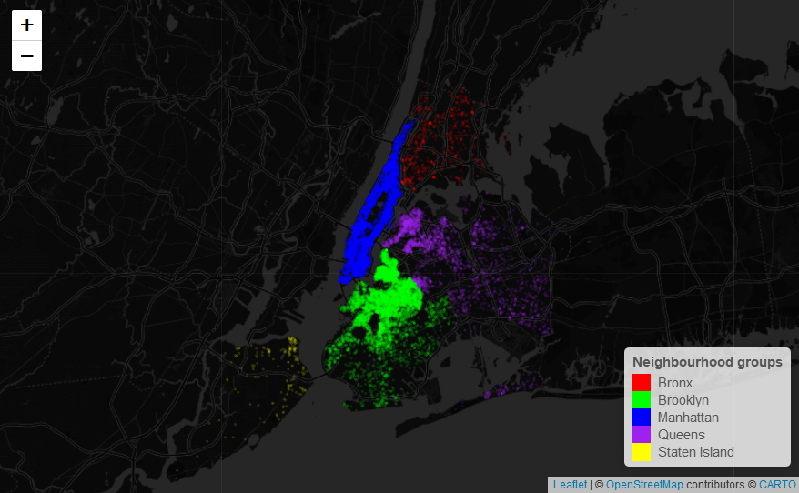
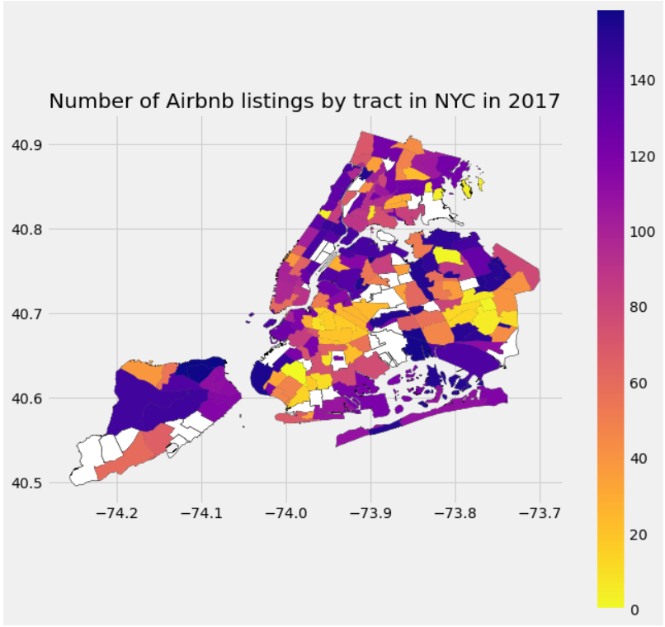
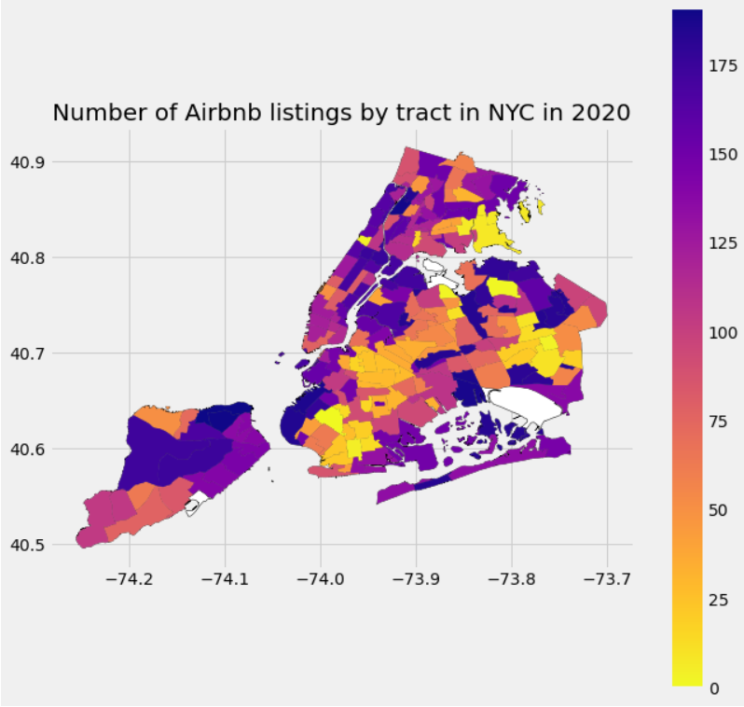
Number of Airbnb Listings by Neighborhoods
Spill over effect?
Areas that are closest to Manhattan and Brooklyn (e.g. East and South of Williamsburg, Northeast of Staten Island, Harlem)
Matches with Rising Star Areas for Luxurious Listings

Slide 12
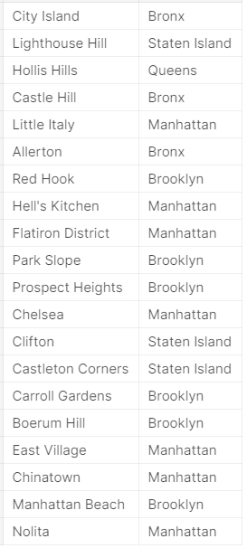
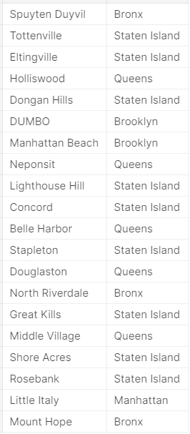
Minimum Revenue Analysis
Top 20 Neighborhoods with highest minimum revenue in 2017 (left) and 2020 (right)
Minimum Revenue per day =
Price per day x Minimum Number of Nights x Number of Reviews (Demand)
[ Previous Literaure: number of user reviews works well as a proxy for Airbnb demand as the completion rate for reviews over the number of stays in an Airbnb accommodation is more than 70% (Quattrone et al. 2016) ]
- Supports Rent Gap Model of Neil Smith (1979)
- Manhattan, Brooklyn ➔ Bronx, Staten Island, Queens

Slide 13
Predictive Modelling of Listing Price

Slide 14
Methodologies
30 ish features including the 6 features I created from the “Listing Name” column (e.g. average word length).
Train: 2016-2019 Data / Test: 2020 data / Cross Validation of Fold 5 on Training Data
Baseline Models: Linear Regularized Models (e.g. Ridge, Lasso, Elastic Net)
Feature Selection: Lasso Feature Selection & Random Forest (RF) Feature Importance
Feature Interpretability: RF Feature Importance & Permutation Importance
Tried various CART derived algorithms (e.g. RF, GBT, XGBoost, LGBM etc.) on both the whole data and feature selected data

Slide 15
Various Model Performances
 | MSE | Median AE | Mean AE | R Squared
Linear Regression | 22959.27 | 30.71 | 49.62 | 0.15
Ridge | 22959.25 | 30.70 | 49.62 | 0.15
Lasso | 22983.24 | 30.59 | 49.49 | 0.15
Elastic Net | 24724.06 | 42.34 | 58.98 | 0.08
Previous Literature
Best Performance
Mean Average Error: 1.3179
MSE: 1.1584
R Squared: 0.6901
Beat Mean Absolute Error and R-Squared but not MSE…
Beat Samuel Lam’s Personal Project Performance of around $22 Median Absolute Error
 | MSE | Median AE | Mean AE | R Squared
RF (n_estimators = 50) | 32.51 | 0.30 | 1.37 | 0.99
GBR (n_estimators = 50) | 14002.13 | 24.75 | 44.08 | 0.48
XGBoost | 5359.64 | 22.49 | 38.30 | 0.80
LGBM | 798.12 | 11.79 | 11.76 | 0.97
RF on features with non-zero RF feature importance (n_estimators = 50) | 22.82 | 0.30 | 1.34 | 0.99
RF on features selected by Lasso (n_estimators = 50) | 17.96 | 0.30 | 1.33 | 0.99
RF on features with non-zero RF feature importance (n_estimators = 300) | 11.34 | 1.18 | 0.47 | 0.99
Bagging + RF on features with non-zero RF feature importance (n_estimators = 300) | 352.01 | 2.94 | 6.36 | 0.99

Slide 16
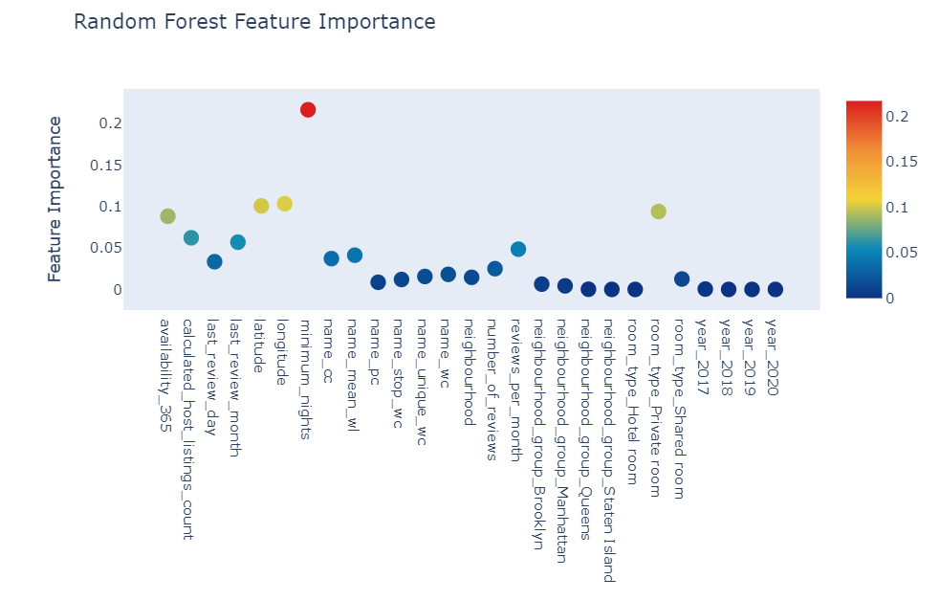
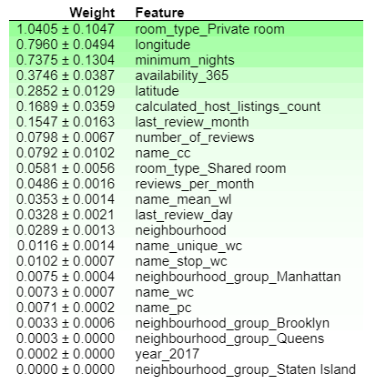
Feature Interpretability
Feature Importance (RF)
Permutation Importance

Slide 17
Accomplishments, Limitations, and Future Work
On-par or was better in listing price prediction performance than previous literature using only the basic and smaller number of features
Identified neighborhoods where gentrification is actively ongoing or have huge potential of gentrification in the near future
Lack of Short Term Rent Supply and Price Data, so can’t completely and accurately gauge the impact of Airbnbs on Short Term Rental Market / Gentrification
Would be interesting to bring ACS Data on a neighborhood level to gauge impact of Airnbnbs on New York City’s various socioeconomic and demographic indicators

Slide 18
Thank you!

